Slide 1
World Electricity Analysis
Group No: 2A
Sumesh Nehete (pd15_010)
Deepak Kumar (pd14_010)
Vaibhav Gupta (pd14_220)
Nisha Agrawal (pd15_064)
Project Guide:
Mr. Aman Vats , Mr. Ajay Katana, Mr. Priyansh Kalawat

Slide 2
Presentation Flow
Introduction
Goal and Objective
Technologies Used
Dashboard/Insights
All Insights and Findings
Challenges & Learnings

Slide 3
Introduction
Electricity is at the heart of modern economies and it is providing a rising share of energy services.
The analysis on the access of electricity in urban and rural areas of different countries and also on the production of electricity by different sources.

Slide 4
Goals and Objectives
Proper understanding and reading the data.
To do various aggregations.
To finding various insights from the above aggregations.
Data visualization of change in electricity access and electricity production in various countries time to time.

Slide 5
Technologies Used
PYTHON (JUPYTER)
MS SQL SERVER
MICROSOFT EXCEL WORKBOOK
MICROSOFT POWERPOINT

Slide 6
Yearly Comparison of electricity access in India

Slide 7
Count of countries with >=75% Electricity Access in Rural Area

Slide 8
Yearly comparison of electricity access of countries with world average access

Slide 9
Comparison of access to electricity post 2000s in different countries

Slide 10
Comparison of different electricity production sources

Slide 11
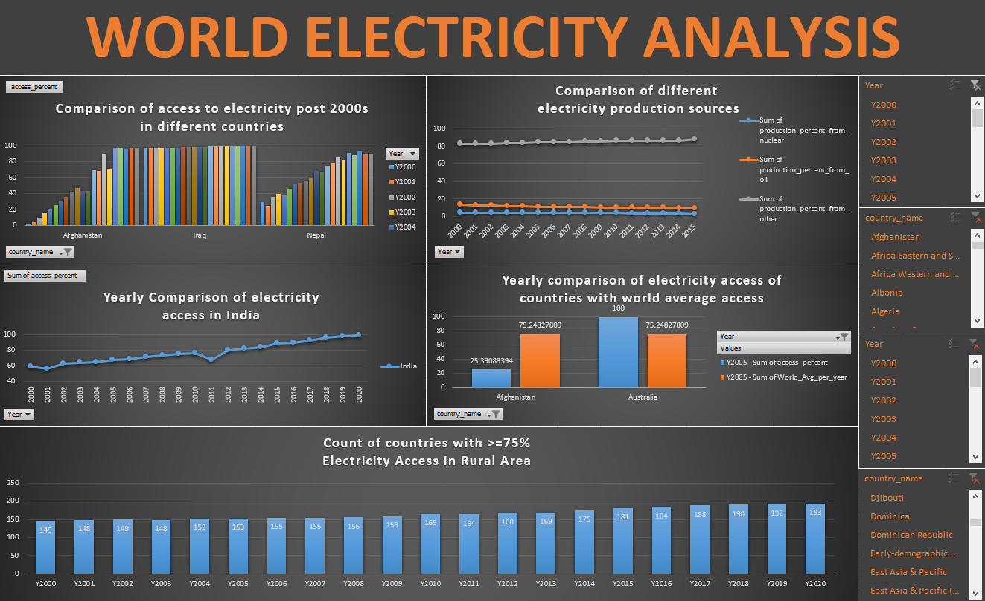

Slide 12
All Insights & Findings
Access of electricity in world is increased in last 20 years where total access% has gone up by 12%; 16% for rural and 7% for urban.
Post 2000, total access% is almost constant or small increment has occurred in developed countries whereas developing countries have shown a high increment.
From 2000 to 2015, electricity production by nuclear has gone down from 4% to 2.5%; 13% to 9% for oil whereas for others it moved up from 82% to 88%. During same period, production by renewable has increased by 730%.
Country with highest electricity (production %) by nuclear is France (78%), by oil is Gibraltar (100%), by renewable is United States (1.5 x 10^11 kwh) whereas country showing highest power loss% is Haiti (52%).

Slide 13
Electricity access in India has increased by 40% in last 20 years.
Country with highest increment in total access % (96%) is Afghanistan whereas country with highest decrement (-30%) is Libya.
Countries with highest increment in rural access % (100%) are Nauro, Sint Maarteen, St. Martin whereas country with highest decrement(-99%) is Libya.
Country with highest increment in urban access % (64%) is Lesotho whereas country with highest decrement (-5.3%) is Kiribati.

Slide 14
Challenges & Learnings
The very first challenge was to read the CSV file in SQL as it was giving default column names. But we got the solution on that after struggling whole day.
The most challenging part was of aggregation in SQL as the data was provided in pivoted format and we have unpivot the data for aggregations.

Slide 15


